Slide 1
NYC Open Restaurants Program
Exploratory Data Analysis
Hyejin Kim
Notes:
For my project, I decided to explore data on the NYC Open Restaurants Program.

Slide 2
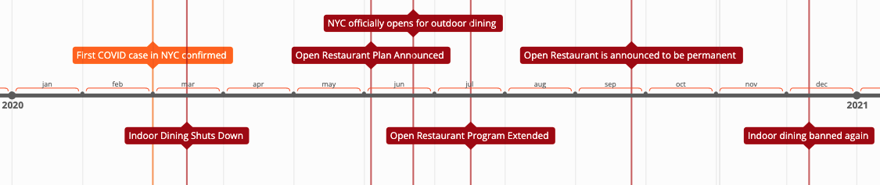
Background
Notes:
To begin, I’ll start with some background. Since the start of COVID in the city, Within a few weeks, the city shut down indoor dining, which was obviously devastating for the restaurant industry. One article I read said that over 1,000 NYC restaurants permanently closed in 2020.
In an effort to save the restaurant industry, NYC launched the Open Restaurants Program in June of 2020. This Program allowed restaurants to take up sidewalk or street space in front of their restaurants for outdoor dining. It permitted restaurants to put chairs, tables, and build shed-like structures outside, with seemingly few restrictions. I’ll show you an example on the next slide..
https://ny.eater.com/2020/12/30/22203053/nyc-coronavirus-timeline-restaurants-bars-2020 (timeline)

Slide 3
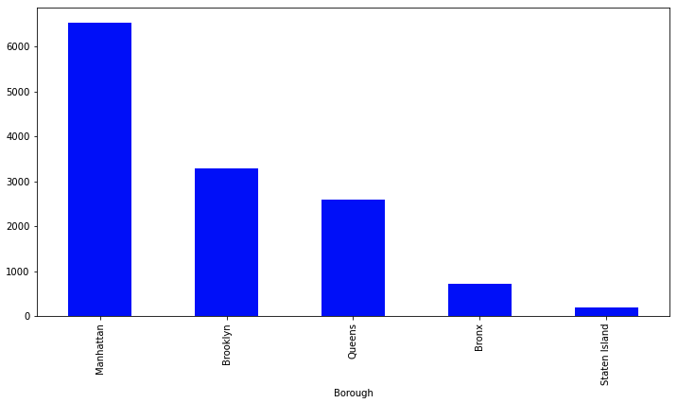
Number of Restaurants That Have Applied for the Open Restaurants Program
Notes:
Since the start, the Open Restaurants Program has been extremely popular. This slide shows how many restaurants have applied for the program by borough. As you can see, Manhattan has the most, with over 6,000 applications, with staten island having the fewest. In total, over 12,000 restaurants in the city have applied for the program.

Slide 4
Data Exploration
The Open Restaurants Program has been a lifesaver for the restaurant industry. Over 100,000 restaurant industry jobs have been saved. But….
How has the increase of restaurants taking up additional street and road space affected NYC resident quality of life?
Data:
Open Restaurants Application (~13k)
311 Complaints (~28m / ~880k)
Notes:
There can be no doubt that the Open Restaurants Program has been a lifesaver for the restaurant industry. One article I read said that the program saved over 100,000 restaurant industry jobs.
And while that is great, I think it is also important to consider any negatives that come with adding over 12,000 outdoor dining areas in the city. So for this project I wanted to explore the data to see how the increase in outdoor dining has affected NYC resident quality of living.
I used two different datasets, both of which the city makes available to the public. The first dataset contains information on all of the Open Restaurant applications that have been submitted since the start of the program.
The second dataset contains information from the city’s 311 complaint program from 2010. If you do not know, NYC has a program called 311, where residents can lodge complaints, essentially for anything whatsoever. I explored these complaints to see whether I could learn anything about how the increase in outdoor dining has affected resident quality of life.
https://www.restaurantdive.com/news/91-of-nyc-restaurants-say-permanent-outdoor-dining-is-very-important-to/618770/ (saved 100,000 jobs)

Slide 5
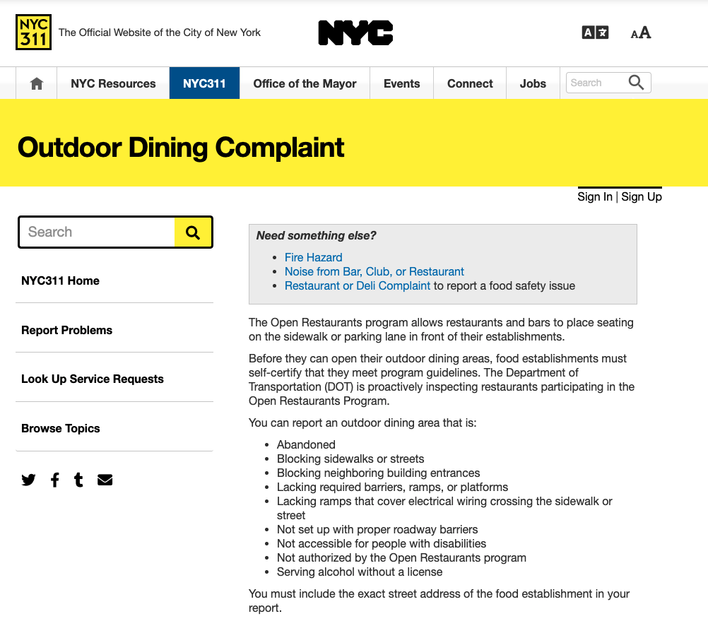
311 “Outdoor Dining Complaint” Category
Notes:
In the 311 complaints dataset, complaints are broken down into dozens of different categories. One particularly relevant category for my purpose was the “Outdoor Dining Complaint” category. The city created this category specifically to track complaints related to the Open Restaurants Program. So I thought it was a good place to start.

Slide 6
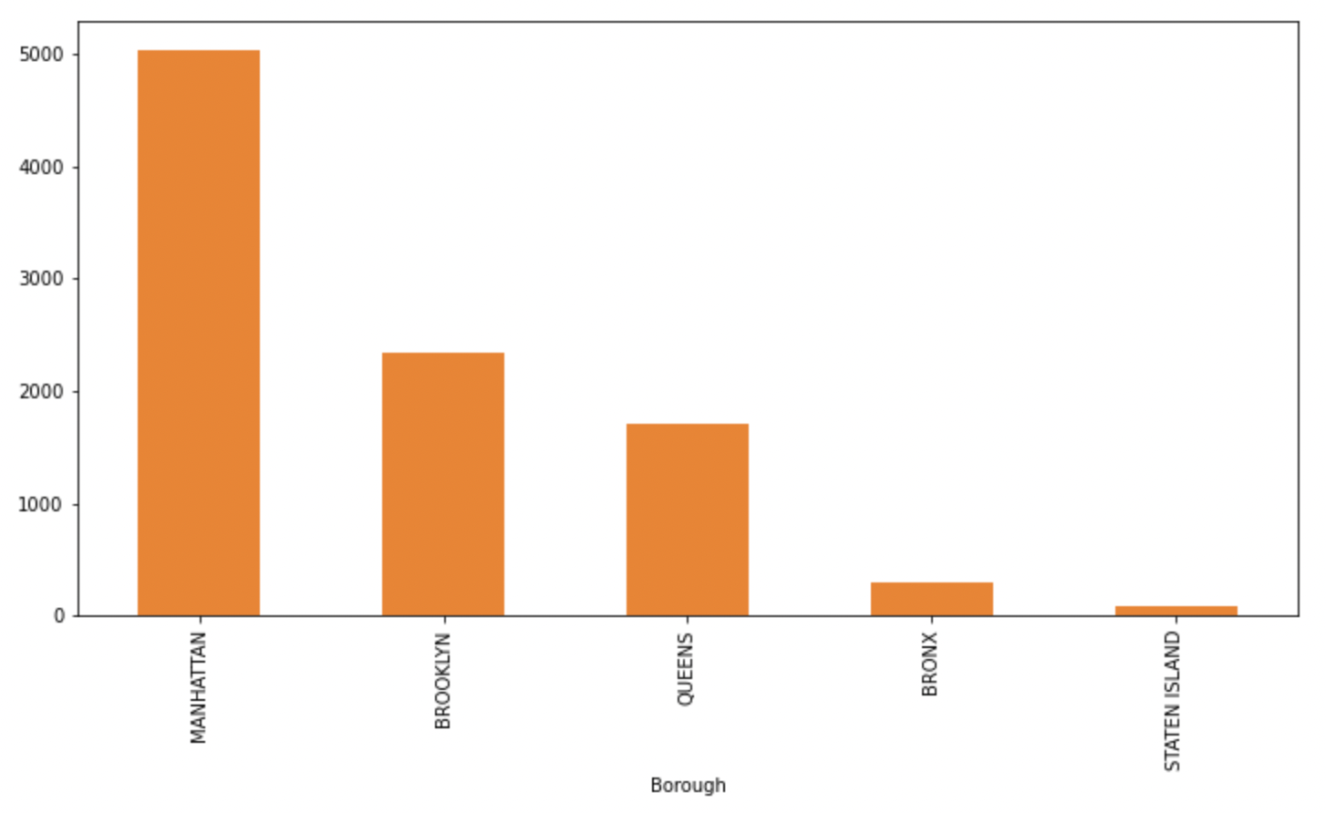
Number of “Outdoor Dining Complaints” Reported
Notes:
So how many “Outdoor Dining Complaints” have there been since the beginning of the Open Restaurants Program? A lot. As you can see in Manhattan, there have been ~5,000 complaints alone.

Slide 7
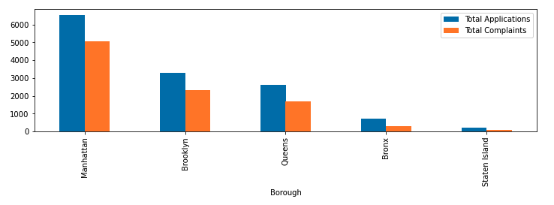
Number of “Outdoor Dining Complaints” vs. Number of Open Restaurant Applications
Notes:
Comparing the volume of complaints to volume of applications per borough, I was somewhat surprised by the sheer number of complaints - There are almost as many complaints as there are restaurants. (I did not de-duplify the data, so I’m sure some restaurants could have received multiple complaints)

Slide 8
Types of Outdoor Dining Complaints
Complaint Description | % Total
Sidewalk Zone Blocked | 39.6%
Site Setup Condition | 31.5%
Barrier Condition | 11.5%
Street Zone Blocked | 11.1%
Unauthorized Restaurant | 3.3%
Table Not in Compliance | 2.7%
ADA Ramp Missing | 0.3%
Utility Cover Blocked | 0.1%
Platform Condition | 0.0%
Notes:
So, there are a lot of “Outdoor Dining Complaints,” but what are those exactly? This slide shows that most of the “Outdoor Dining Complaints” fall into a few categories, such as “Sidewalk zone blocked” or “Site setup condition.”
While these complaint types provides some useful data:
For example, residents clearly feel affected enough by blocked sidewalks and poor site setup conditions to submit a large number of complaints.
But these descriptors don’t paint the full picture for assessing impacts to resident’s quality of life.
So I decided to look into the wider 311 dataset to look at other related complaint categories.

Slide 9
Relevant Quality of Life (“QOL”) Complaints Not Accounted for in the “Outdoor Dining Complaint” Category
Dirty Conditions
311’s description:
Improper disposal/Dumping
Dirty sidewalk, Trash, Spillage
Rodents/Insects
Illegal Parking
311’s description:
Blocked Driveway/Bike Lane/Hydrant
Double Parking
Parking Sign Violation
Outdoor Noise (commercial & street)
311’s description:
Loud Music/Party
Loud Talking
Notes:
The wider dataset consists of over 28 million records, dating back from 2010, with dozens of complaint categories with even more different types of sub-categories within.
I first identified what I thought were relevant complaint types and then grouped them into three main categories.
One category I created was for “dirty conditions.” For this category I grouped complaints related to waste and dirty sidewalk conditions. If you live in the city, you know that many of the shed-like structures that have been erected are a magnet for trash and rodents, so I was curious as to whether these complaints have increased since the start of the Open Restaurants Program.
The next category was for “illegal parking.” I included complaints that 311 had characterized as “blocked driveway/bike lane/hydrant,” “double parking,” or “parking sign violation.” Many of the outdoor dining structures have been built on top of parking spaces so I was curious as to whether the reduced number of available parking spaces has resulted in cars having to park illegally elsewhere, such as in front of driveways.
Last, I created a category for “outdoor noise.” I included complaints that 311 had characterized as “loud music/party and loud talking” I excluded any complaints that were for residential buildings, given that I was only interested in noise that was coming from outdoor dining.
Together, I’ll refer to these three categories of complaints as “quality of life” complaints.

Slide 10
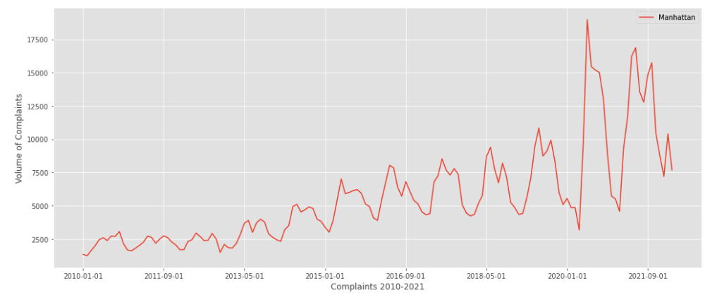
Relevant QOL Complaints in Manhattan (2010-2022)
Notes:
This chart shows the number of relevant Quality of Life complaints going back to 2010 for Manhattan. You can see that during pre-pandemic times, there was a general trend upwards for these complaints (with seasonal spikes for each summer/fall time periods). But what is really interesting is what happens post-pandemic. From this chart, you can see that there was a huge influx in these relevant quality of life complaints beginning in 2020. I’ll zoom in for a closer look.

Slide 11
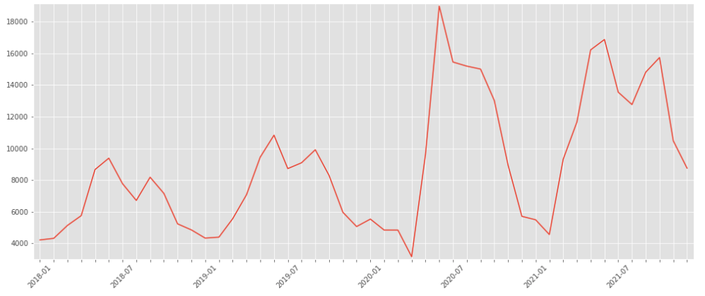
Closer look
Restaurants Close
Stay at home orders begin
Open Restaurants Announced
Notes:
This chart shows the same data, but is zoomed in to show only the past five years so that we can better see what happened during the pandemic.
I’ve marked the date that restaurants were ordered to close and residents were encouraged to stay at home. I’ve also marked the beginning of the Open Restaurants Program. As you can see, the beginning of the Open Restaurants Program coincided with a huge influx in complaints.

Slide 12
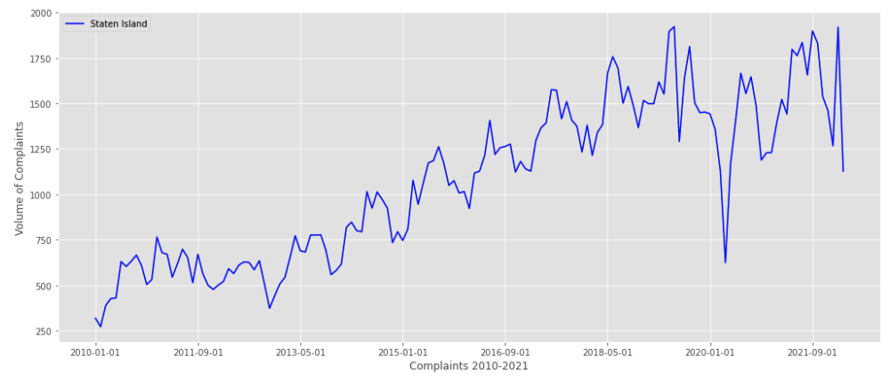
Comparing Trends
Manhattan:
Large volume of Open Restaurants
Huge spike in relevant QOL complaints compared to historical trend
Staten Island:
Smallest volume of Open Restaurants
No spike in relevant QOL complaints compared to historical trend
Notes:
So we know there was a huge spike in complaints in Manhattan around the time the Open Restaurants Program began. But can we attribute that to the Open Restaurants Program, or may there be some other cause? I wanted to explore the data a little bit more on this point.
The top of this slide again shows the data for manhattan.
But now, I’ve also included data for Staten Island. If we go back to earlier in my presentation, you’ll recall that Staten Island had the smallest volume of Open Restaurant applications. Since the volume of open restaurants are very low in Staten Island, we wouldn’t expect to see the same surge in complaints filed.
And the data shows that to be the case. As you can see, starting in 2010 until present day, there is a general upward trend in the number of complaints in Staten Island, but there is no spike in complaints around the time the Open Restaurants Program began. In fact, the complaints in Staten Island today are about the same or even less than they were pre-pandemic.

Slide 13
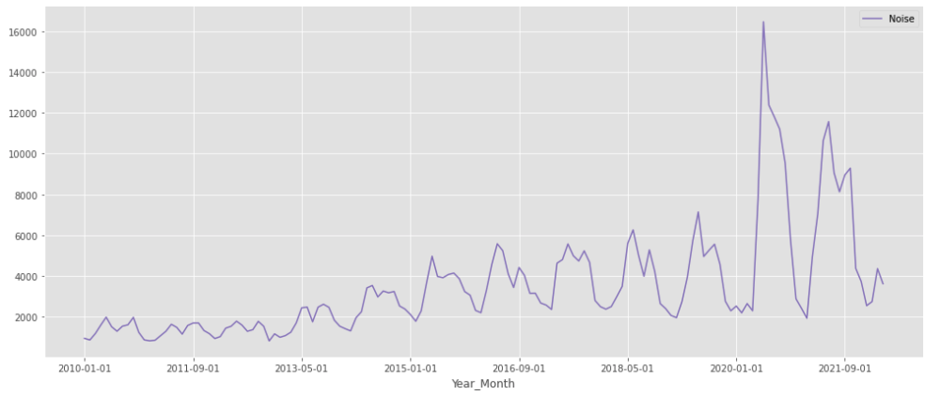
Outdoor Noise Complaints (Manhattan 2010 - to date)
Notes:
Taking a closer look at each complaint, I broke out the trends to see which had the highest impact. This first view is filtered for outdoor noise complaints in manhattan from 2010 to date. We can see there are 2 large noticeable spikes in the summer seasons post COVID with the first spike coinciding with the opening of the open restaurant program. The month of June 2020 had over 16k+ outdoor noise complaints in manhattan alone! June 2020 was also the beginning of phase 1 opening for the city and people were coming out of a 3 month stay at home order - I suspect people were probably very excited to dine outdoor.
The following summer of 2021 was not as high as 2020 but still almost twice as much as it was pre-pandemic era.

Slide 14
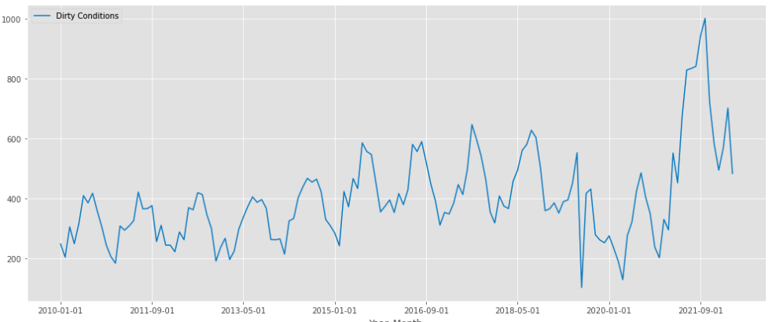
Dirty Condition Complaints (Manhattan 2010 - to date)
Notes:
As for dirty conditions, we see a noticeable spike but it does not occur until 2021 summer/fall. There was actually a decrease in 2020.

Slide 15
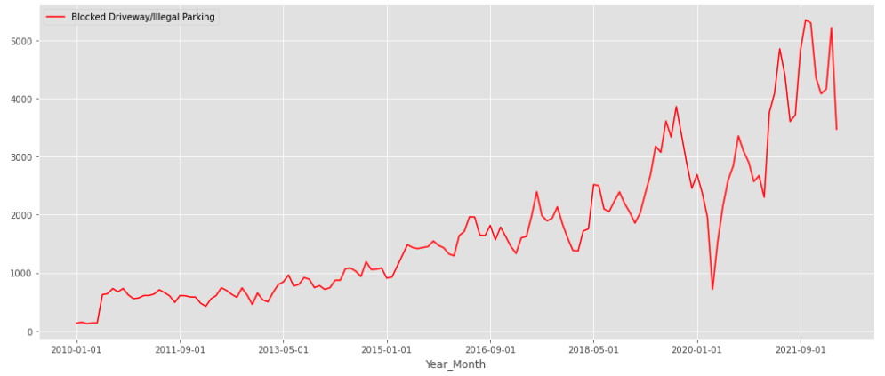
Illegal Parking Complaints (Manhattan 2010 - to date)
Notes:
As for illegal parking complaint, other than the significant dip during the beginning months of covid with lockdown, surprisingly - we don’t see a significant surge in parking space related complaints as we did for noise and dirty conditions. It seems to follow the general upward trend since 2010.
With these breakdowns, it is clear that noise was the predominant factor driving complaint volume amongst these categories.

Slide 16
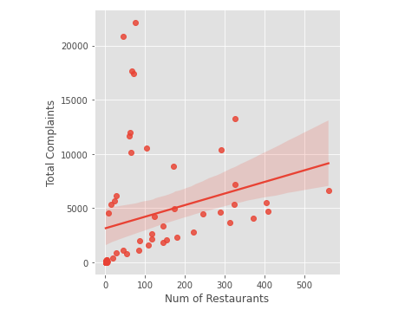
Complaints & Open Restaurant Density by Zip Code
Relationship between Open Restaurant density and volume of complaints
Outliers were all in the same general area
Notes:
Lastly, I wanted to view this relationship directly with a scatter and linear model plot.
I aggregated the volume of restaurants and complaints per zip codes to see if we can view any visual evidence that observes a relationship between these two variables.
Asides from the 4 obvious outliers, there seems to be a relationship, where there are greater complaints lodged in these categories within the areas with greater open restaurant density.
Side note, i looked into the 4 outlier zip codes and they all happen to be in the inwood/washington heights area and upon some googling found a NY Post article that describes these neighborhoods as famous for residents lodging the most noise complaints ever since the 311 help line was created.
With more time, I’d like to break out this model by complaint category, as it seems like data for noise is significantly higher in some areas in general.

Slide 17
Takeaways & Next Steps
Takeaways:
Next Steps:
Data appears to show a relationship with rise of Open Restaurants having an impact on NYC resident quality of life
Largest spikes in complaints found in Noise and Dirty Condition complaints
Did not find sufficient data that shows significant impact on illegal parking
Clean up graphs so that the date marker intervals and labels are intuitive
Explore impact to traffic
Explore other contributing factors ie: changes in population density, etc
Continue to look into the data as program matures to see future trends
Notes:
Takeaways & Next steps:
The data seems to present that there was a rise in some key complaints that coincide with the start of the open restaurants program. The most significant impact was related to noise complaints amongst the 3 categories discussed.
Did not find sufficient data that shows significant impact on illegal parking but perhaps this is to be expected as parking has higher repercussions resulting in fines and ticketing
With Open Restaurant program becoming a permanent fixture for the city with better guidelines and more restrictions since the start of the program, we’d hope to see some improvements in the coming summers

